Slide 1
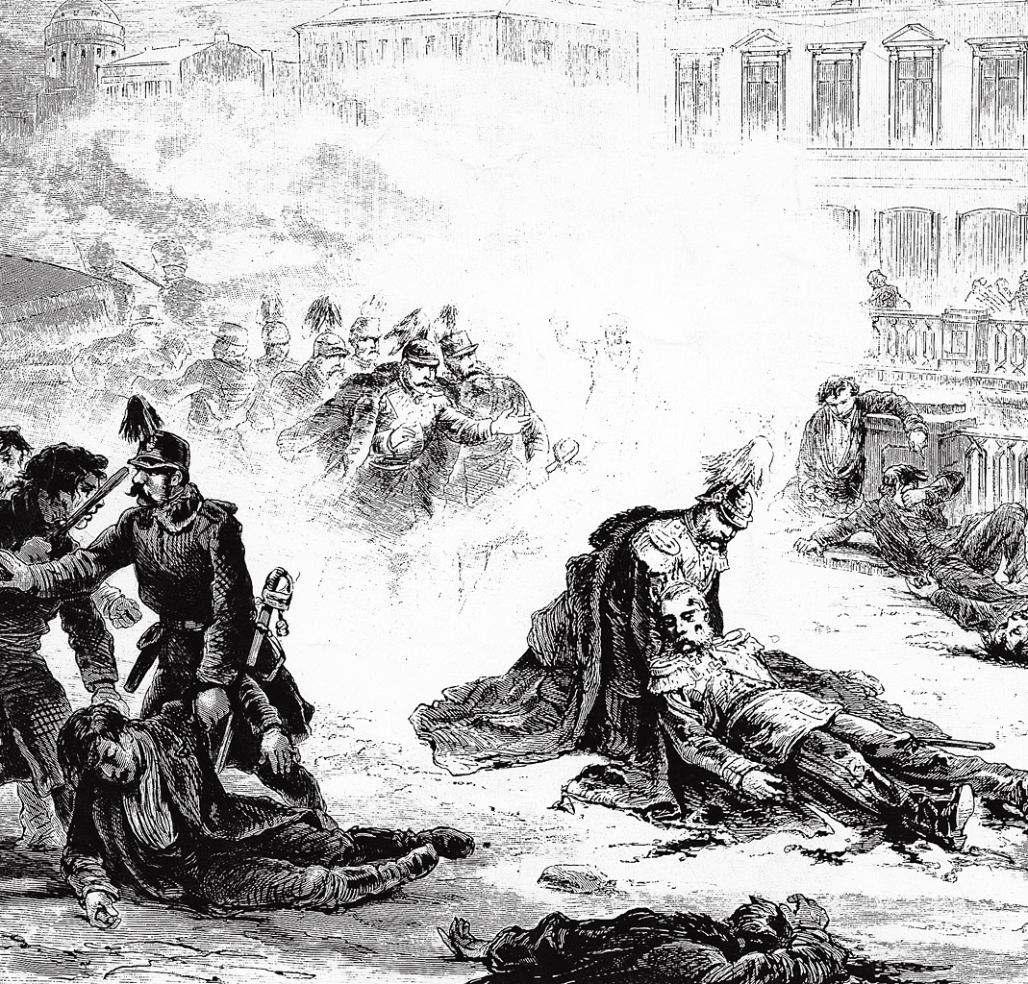
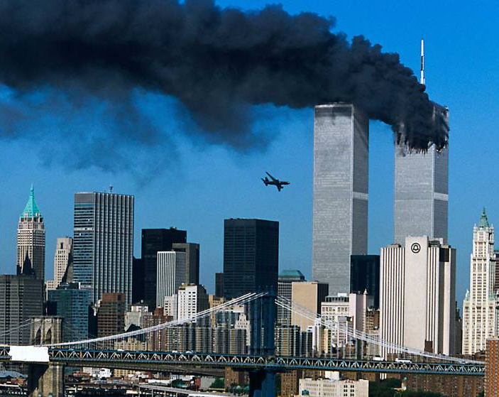
STRATEGIES OF TERRORISM
John Lynn, ACDIS
Department of History

Slide 2
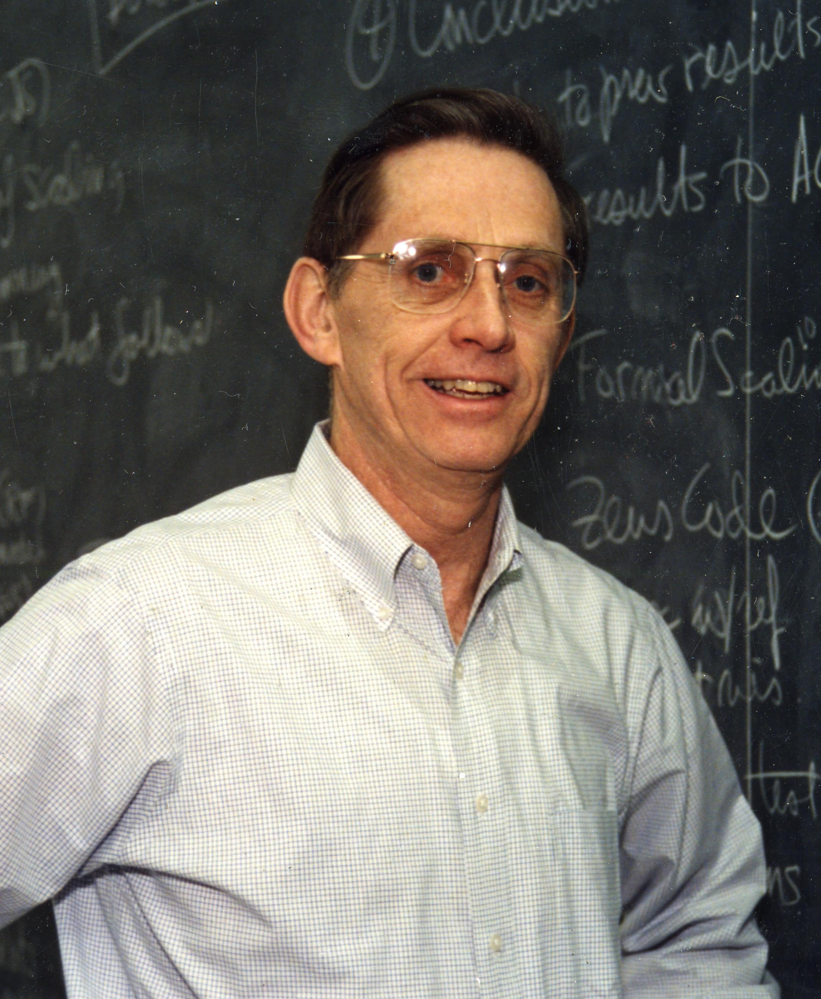
Thank you,
Jeremiah.

Slide 3
Raymond Aron, wrote:
“An action of violence is labeled ‘terrorist’ when its psychological effects are out of proportion to its purely physical results.”

Slide 4
VIOLENCE
PSYCHOLOGICAL IMPACT
POLITICAL EFFECT

Slide 5

VIOLENCE
PSYCHOLOGICAL IMPACT
POLITICAL EFFECT

Slide 6
IN SHORT, TERRORISM IS A FORM OF PSYCHOLOGICAL ASSAULT, OR WARFARE, THAT
WEAPONIZES THE EMOTIONS, MOST NOTABLY FEAR AND OUTRAGE.
KNOWLEDGE AND UNDERSTANDING ARE AMONG OUR BEST MEANS TO DEFEAT TERRORISM.

Slide 7

Fundamental
Theses

Slide 8
Six Levels of Terrorism

Slide 9
More
Fundamental
Theses

Slide 10
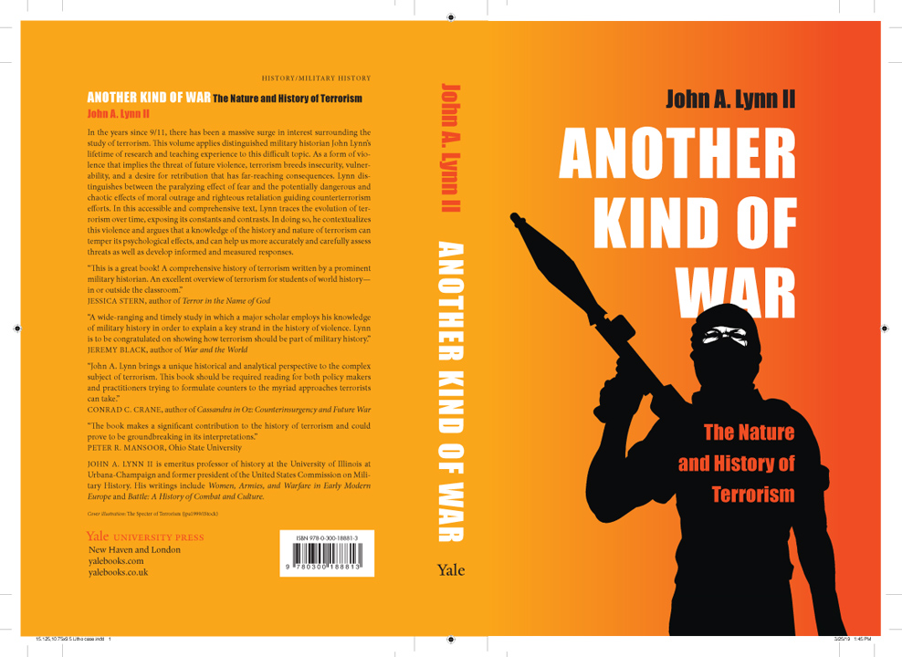

Slide 11
Terrorists see themselves as fighting a war to defend or promote an essential and just cause.
Terrorists are “surprisingly normal,” not clinically psychotic.
Terrorists are rational actors.
And, being rational actors at war, they pursue strategies.

Slide 12
WAR AIMS, GOALS –
The purpose of the war
STRATEGIES –
How to conduct a war
TACTICS –
How to fight a battle
STRATAGEMS –
Tactics of deceiving or
outwitting the enemy

Slide 13
Four Strategies of Terrorism
STRONG WEAK

Slide 14
INTIMIDATION
Primary for Strong-Capacity Terrorists
  EMPHASIS ON FEAR
  Want acquiescence, obedience, submission, end to resistance
  No use for inciting reprisals by OUTRAGE
Useful for Weak-Capacity Terrorists
  Fear among target community
  Revolutionary discipline within the group
  Compel radical rivals to give way or join

Slide 15
Four Strategies of Terrorism

Slide 16
INITIATION
  For Radical Terrorists who want to act as a precipitant or a catalyst.
  Want to exploit the OUTRAGE of the enemy oppressors so as to reveal the Wickedness and Weakness
  of the oppressors.
  Appeals to very weak groups with great expectations but few resources, explaining why most terrorists of the first and second waves failed.

Slide 17
ATTRITION
For somewhat stronger radical terrorists, who cannot overpower the enemy, but have sufficient numbers and resources to inflict losses on their enemy.
Want to get the enemy to invest unsustainable psychological and physical resources until worn down.
Second Wave PIRA began with a strategy of Initiation, 1970-1972, but by 1976-77 adopted Attrition in the “Long War.”

Slide 18
EVOLUTION
A strategy of moving to higher levels of strength, resources, and numbers.
Important question: need it be theory, intention, or simply opportunism?
Theory of escalating stages goes back to Mao.
Particularly prominent in Third Wave.

Slide 19
EXAMPLES OF EVOLUTION
FLN of Algeria(?)
PLO
FARC of Columbia
Tamil Tigers of Sri Lanka
Hezbollah of Lebanon
Hamas of Gaza
FROM ZARQAWI’s JTJ AND AQI TO TO AL-BAGHDADI’S ISI AND ISIS, THEN FINALLY TO HIS
ISLAMIC STATE

Slide 20
Four Strategies of Terrorism

Slide 21
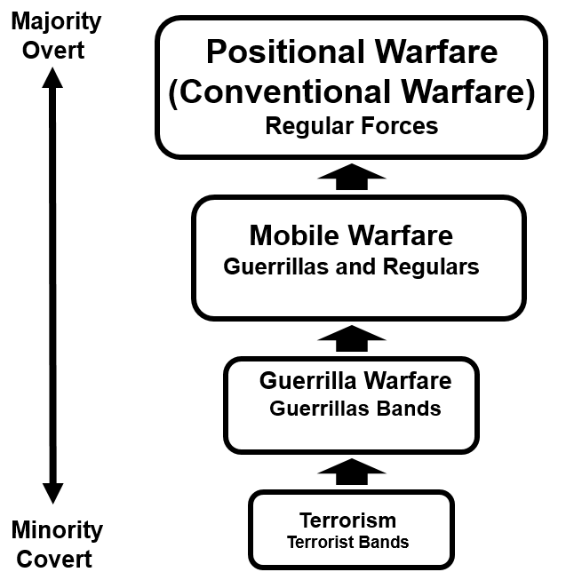
MAO ZEDONG’S PROGRESSION OF REVOLUTIONARY WARFARE
Guerrilla Warfare
Guerrilla Bands
Terrorism
Terrorist Cells

Slide 22
Guerrilla Warfare
Guerrilla Bands
Terrorism
Terrorist Cells

Slide 23

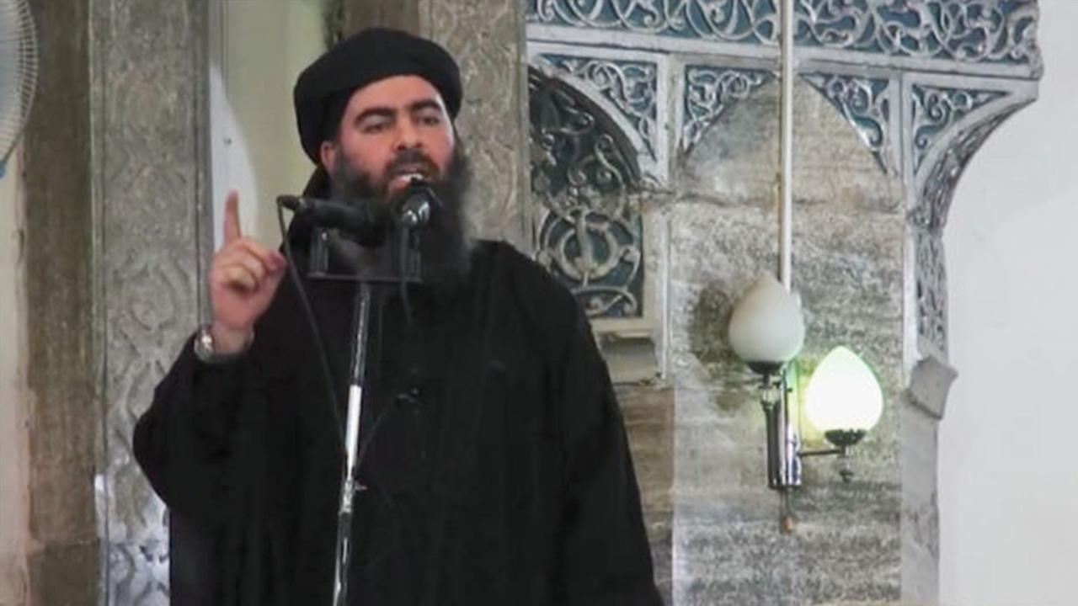
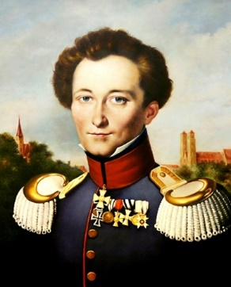
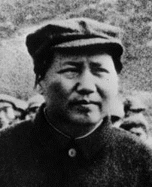
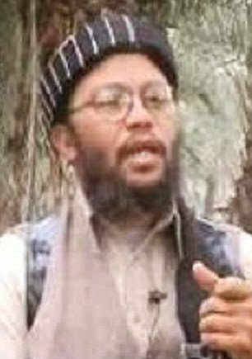
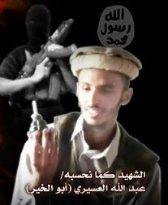
Terrorists Study Military Theory
and Practice
Abu Ubayd al-Qurashi
d. ca. 2006???
Abu Bakr
al-Baghdadi
b. 1971
Carl von
Clausewitz
Mao
Zedong
Abu Bakr Naji
c. 1961-2008
The Mastery
of Savagery
Abd al-Aziz
al-Muqrin
(1971-2004)

Slide 24
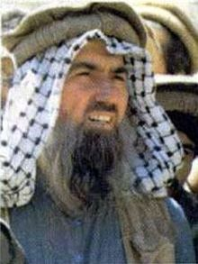
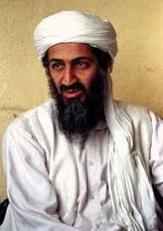
Global STRATEGIES
Global Participation Global Conflict
Abdullah Yusuf Azzam
Osama bin Laden

Slide 25
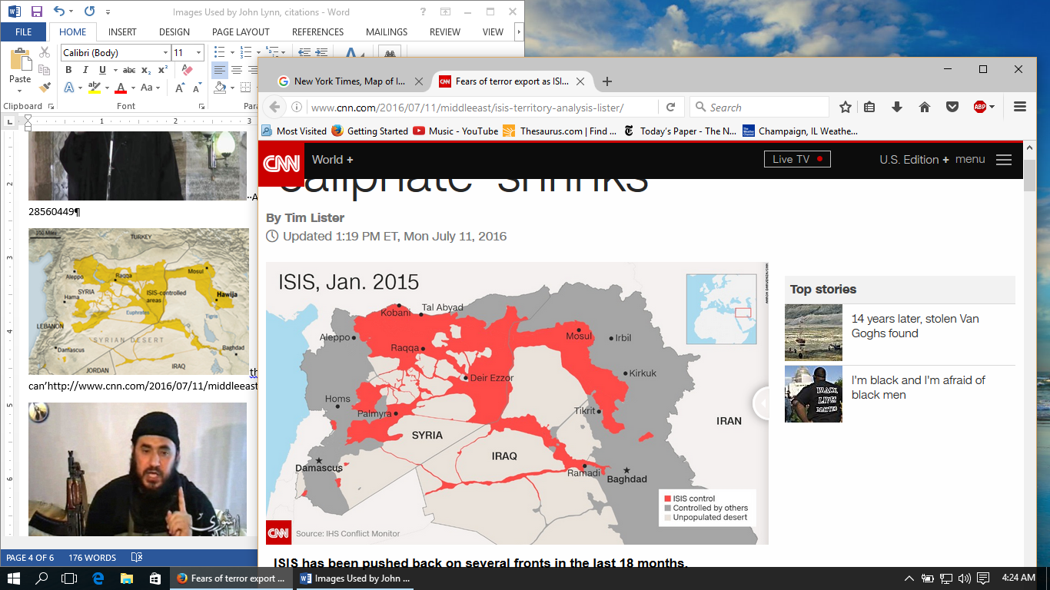
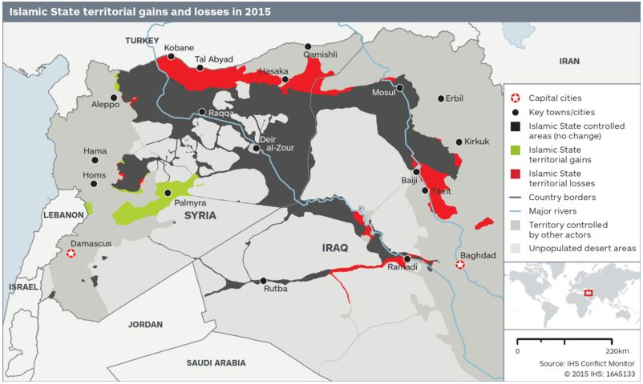
The Islamic State, Jan. 2015
Is this a terrorist “group”?

Slide 26
WHAT IS A STATE?
TERRITORY
RESOURCES
FORCES
MONOPOLOLY OF VIOLENCE
“CIVILIZED” BEHAVIOR

Slide 27
Four Strategies of Terrorism

Slide 28
Four Strategies of Terrorism

Slide 29
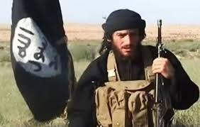
Abu Mohammad al-Adnani

Slide 30
Evolution and De-evolution
Abu Mohammad al-Adnani’s final address in May 2016 warned: “Or do you, O America, consider defeat to be the loss of a city or the loss of land? Certainly not! We would be defeated and you victorious only if you were able to remove the Qur’an from the Muslims’ hearts.” …..“We fight in obedience to Allah and to become closer to Him. And victory is that we live in the might of our religion or die upon it. It is the same, whether Allah blesses us with consolidation or we move into the bare, open desert, displaced and pursued.”

Slide 31
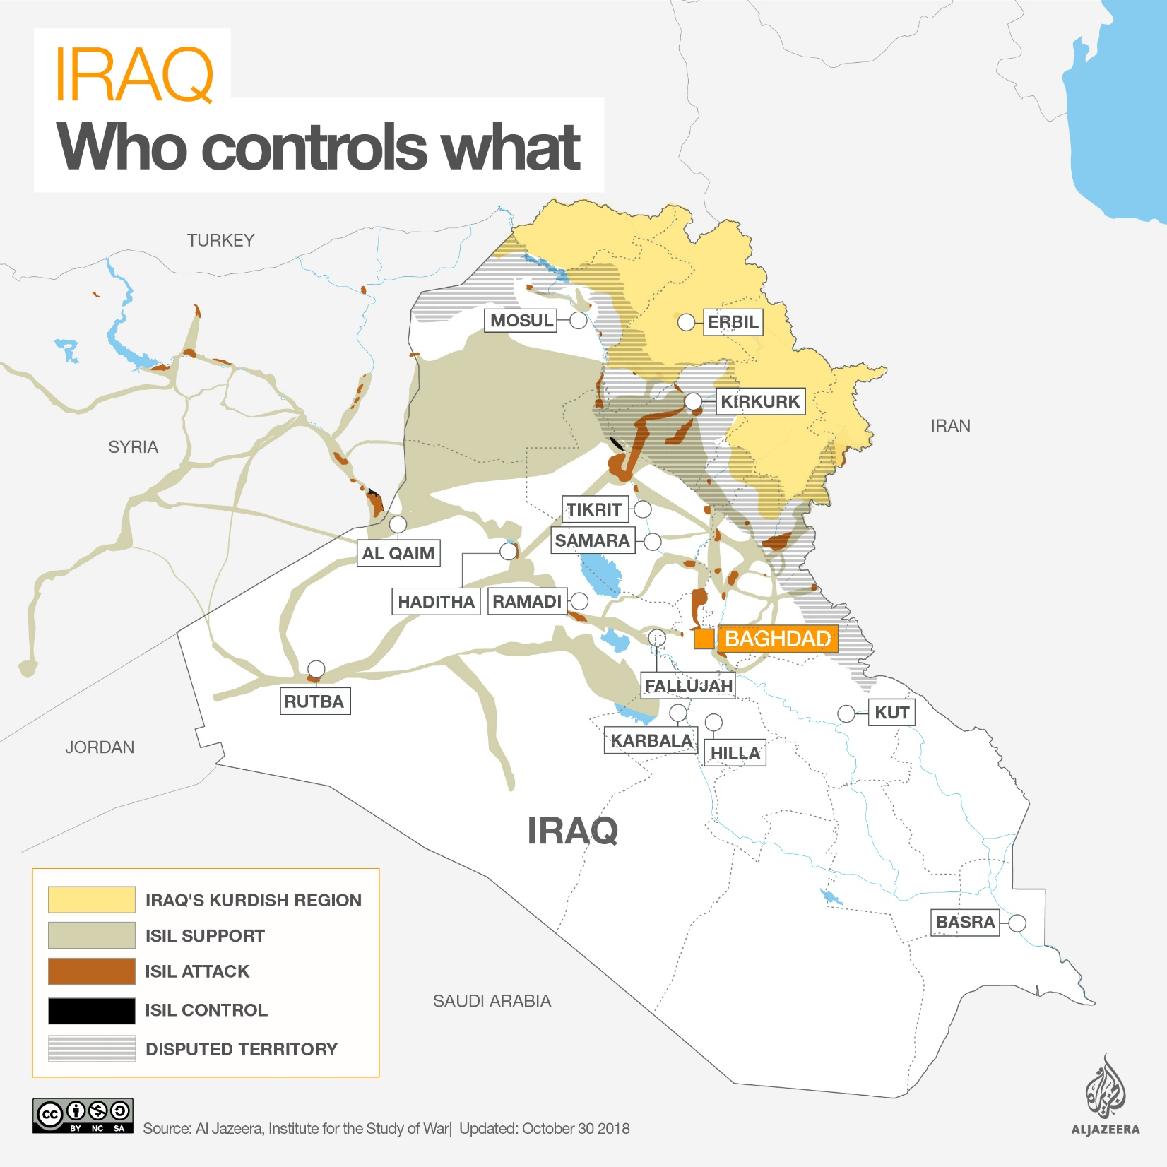
October 2018

Slide 32
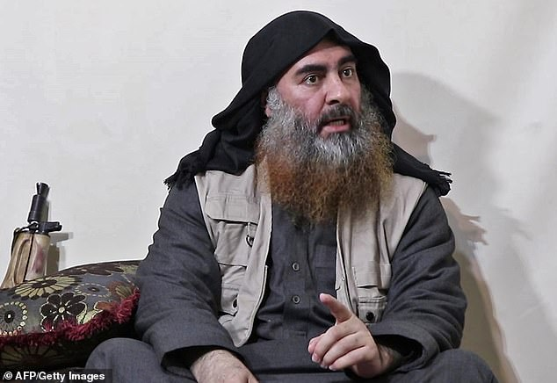

Slide 33
WHAT IS NEXt
FOR THERE WILL BE a next. terrorism is too easy, and it is Absolutely part of the modern repertoire of violent political resistance.
?

Slide 34
COMBATTING TERRORISM
BY CIVIC EDUCATION
VIOLENCE
PSYCHOLOGICAL IMPACT
POLITICAL EFFECT

Slide 35
WHAT I HOPE TO TEACH:
COMPASSION FOR THE IMMEDIATE VICTIMS OF VIOLENCE
UNDERSTANDING THE REAL THREAT
SENSE OF PROPORTION ABOUT THE DANGER AND THE RESPONSE
RESOLUTION TO AVOID BECOMING THE TERRORIST’S UNWITTING ALLY

Slide 36
Thank you,
Jeremiah.

Slide 39
Six Traits of Acts of Terror(ism)
1. The use of violence or the threat of violence
2. directed against the persons or property
3. of those unable or unprepared to defend themselves,
4. primarily to create fear and/or outrage
5. through the propagation of public knowledge,
6. with the intention of affecting public policy or community action.

Slide 40
Daniel Fromkin: Political Jujitsu
(Provocation and Outrage)
“[Terrorism’s] ingenuity l[ies] in using an opponent’s own strength against him. It [is] a sort of jujitsu.”
Knowledge and understanding, can keep you from allowing outrage to make you the terrorists’ unwitting ally.

Slide 41
To be Radical Terrorism, it must be an “ism,” part of a repertoire of violent political resistance. (Charles Tilly)
Radical Terrorism is a form of warfare: entry-level warfare.

